Slide 1


Encrypted LSB Steganography Implementation with AES-128 accelerator (Pakistan 2)
Team Members
Abdul Moiz Sheikh
Ruhma Rizwan
Ali Sabir
Osama Liaqat
Mubashir Saleem

Slide 2
Contents
Introduction and Background
AES-128 Encryption
LSB Steganography
Module Integration
Top Level Integration
Fail Over Strategy
Plan Ahead

Slide 3
Introduction and Background
Motivation:
Increasing need of Data and Information Security.
Increasing volumes and velocity of data.
Steganography:
The art of concealing some secret information (payload) inside non-secret information (or cover).
Encryption:
Encryption transforms the secret information (payload) into some gibberish (cipher text) with the help of a secret password (key).
The intended receiver can decode the cipher text if they have the appropriate key to get the actual payload.

Slide 4
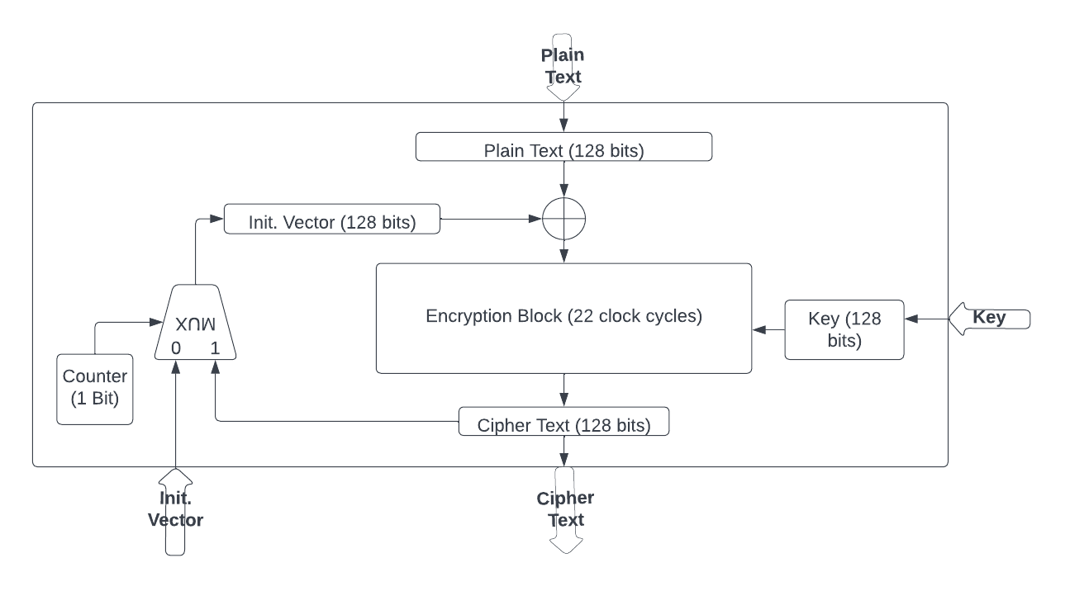
AES-128 Encryption
We are using the Cipher Block Chaining (CBC) mode of operation in order to achieve more randomness.
Counter, initially 0; retains value of 1 after first change in output.

Slide 5
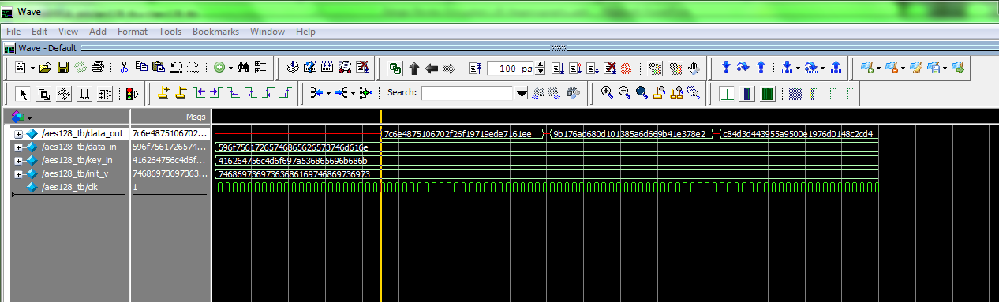
AES-128 Encryption contd.
Simulation Results:
The output is received after 23 cycles
The output changes despite of input remaining same testament to change in Initialization Vector (IV).

Slide 6
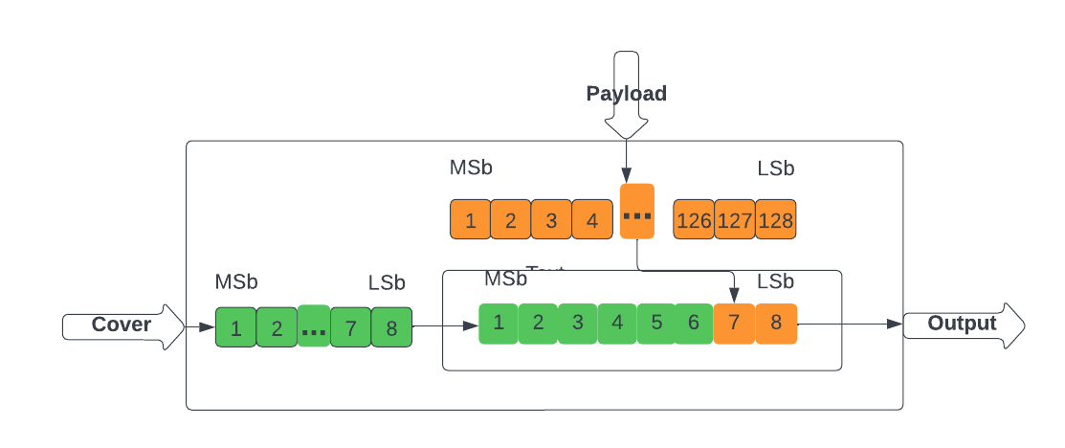
LSB Steganography
We are using the last two bit planes of the cover data to embed the payload for achieving higher throughput.
The embedding sequence is Most Significant bits (MSb) first i.e. in the first byte of cover data, the two MSb’s are embedded and so on to the last two Least Significant bits (LSb).

Slide 7
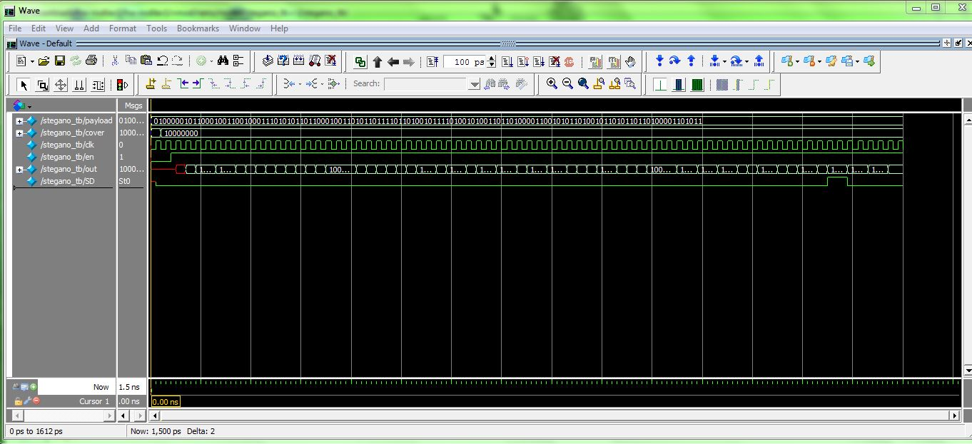
LSB Steganography contd.
Simulation Results:
The output is sent byte by byte.
Each byte has 2 bits of payload (128 bits total); resulting in 64 clock cycles in delivering complete payload.

Slide 8
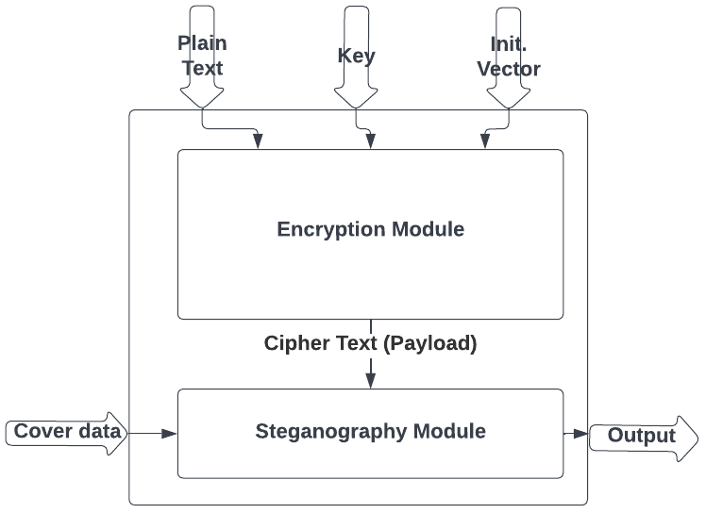
Modules Integration
The two modules are integrated such that; Encryption runs and raises a flag after 23 cycles when it is done
This flag acts as an enable for the steganography block which runs for 65 cycles and raises a flag after embedding all bits of payload (cipher text) in cover data.

Slide 9

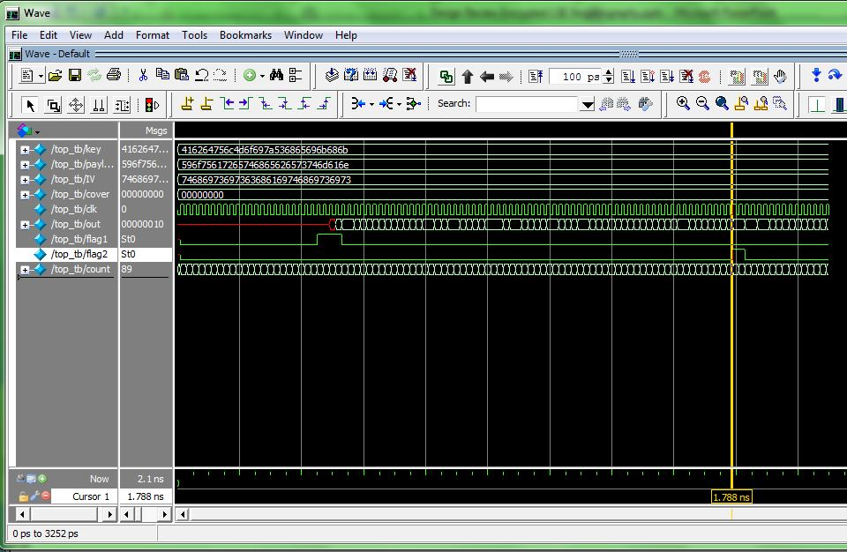
Modules Integration contd.
Simulation Results:
The steganography flag acts as control for encryption block to transfer the next set of 128 bits of payload to steganography block for next round.

Slide 10
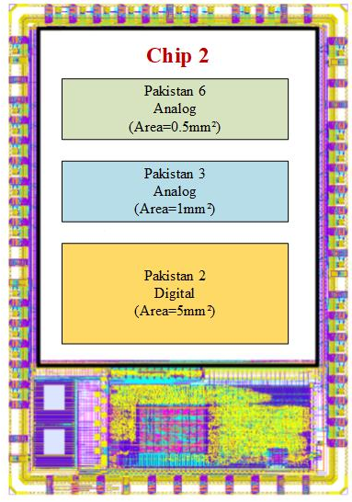
Top Level Integration
The Proposed Top Level Integration (TLI) is requested on the basis of feasibility as well as area and Pin requirement.
Given Below is a rough sketch of Top Level Integration for the chip.

Slide 11
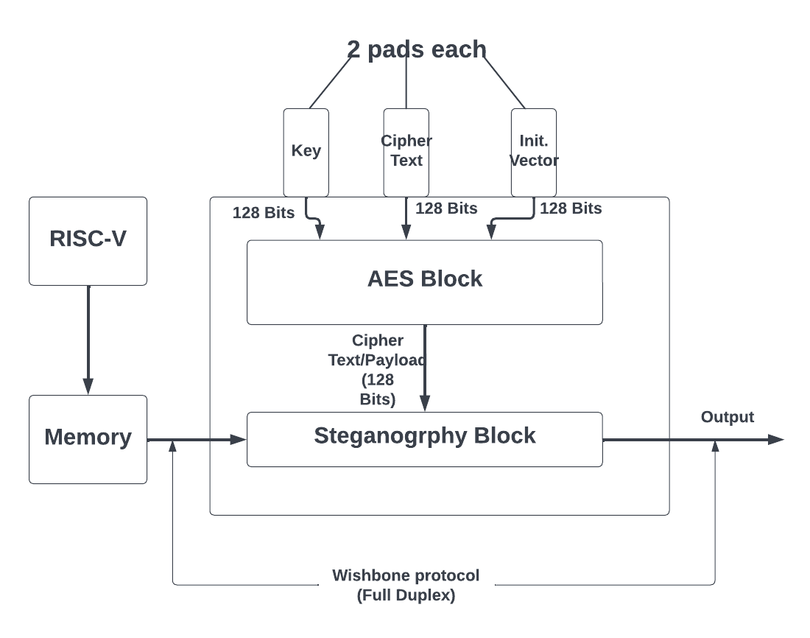
Fail Over Strategy
The project uses built in clock and reset of the Wish-bone bus as well as the data line for the Cover data.
In case of issues with the built in control signals, the external pads are reserved for operating the chip with these external signals.
Top level Block Diagram of the project with internal signals working is given below.

Slide 12
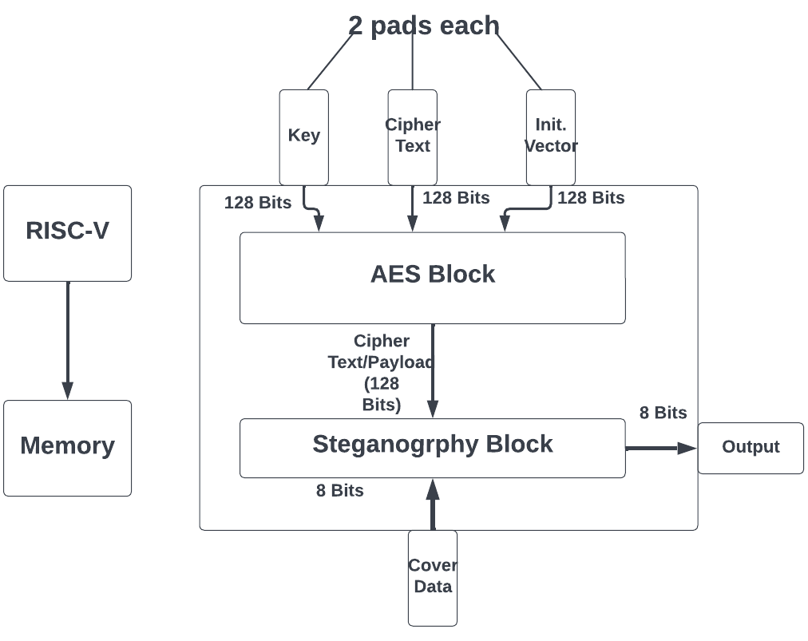
Fail Over Strategy (contd..)
In case the clock, reset or cover data have to be switched to external signals; a separate external “Select” signal is kept as an input to switch each of the three inputs. (To be implemented with TLI)
Top level Block Diagram of the project with internal signals not working is given below.

Slide 13
Plan Ahead
Functionality | Duration
Final Functional Testing of Design | 3 Days
“Select” signal implementation | 5 Days
Backend Runs and GDS=I creation | 15 Days
Top Level Integration and final GDS=II creation | 15 Days

Slide 14
Thank you
آپ کا شکریہ

